Slide 1
Text-to-SQL Semantic Parsing for Vietnamese

Slide 2
Introduction
Semantic parsing is the task of converting natural language sentences into meaning representations such as logical forms or standard SQL database queries

Slide 3
Dataset
Vietnamese version of the Spider dataset, VinAI Research
Human-translated, results on this dataset is comparable to that for English

Slide 4
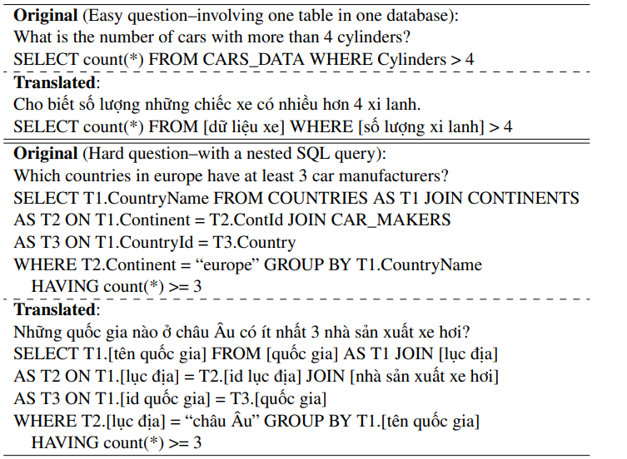

Slide 5
What will we do?
Apply SOTA model on English dataset to Vietnamese dataset

